Slide 1
Cardiopulmonary Exercise Testing
Name
Institution
Date

Slide 2
Introduction
What is Cardiopulmonary Exercise Testing?
Cardiopulmonary Exercise Testing commonly known as CPET
Is a non-invasive technique used to evaluate the heart and lungs performance when a person's body is at rest and exercising (Mezzani, 2017)
Notes:
Cardiopulmonary Exercise Testing is a method used to gauge the performance of the heart and lungs when the body is at rest and during exercise activities (Mezzani, 2017).

Slide 3
Who needs a Cardiopulmonary Test?
People who need to undergo a cardiopulmonary test include:
Individuals scheduled for a major surgery
Individuals being tested for the diagnosis of a heart or lung disease
Individuals in rehabilitation following a major illness (Faghy, et al 2020).
Notes:
Some of the people that need to take a cardiopulmonary test include individuals who are reestablishing themselves health-wise after a major illness (Faghy, et al 2020). People who are scheduled to undergo a major surgery should also take a cardiopulmonary test to ensure their heart and lungs can handle the procedure. Lastly, persons being tested for a diagnosis of heart or lung disease usually take a cardiopulmonary test.

Slide 4
Operations during a Cardiopulmonary Test
During a cardiopulmonary test
A person performs mild exercises on a bicycle ergometer or treadmill
While breathing through a mouthpiece
Each breath is analyzed before and after the exercise.
Notes:
A cardiopulmonary test usually takes approximately forty minutes. The patient's heart rate, rhythm, blood oxygen levels, and performance are measured before they start exercising. The person is then instructed to perform mild exercise on a bicycle ergometer or treadmill for about ten minutes while their lung and heart capacity are observed and measured.

Slide 5
Equipment's for Cardiopulmonary Exercise Testing
Some of the pieces of equipment used to perform a Cardiopulmonary test are;
bicycle ergometers
treadmills
Pulse Oximeters
Echocardiogram
Stress and Blood Pressure Monitors
Notes:
Several pieces of equipment are used when performing a cardiopulmonary test. Some of the pieces of equipment include treadmills, bicycle ergometers, pulse oximeters, echocardiograms, and stress and blood monitors.

Slide 6
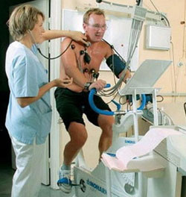
Bicycle Ergometers
machines used for cardio training and
Measuring of heart and lung capacity (Older & Levett,2017)
A person is required to perform mild exercise on the bicycle ergometer
While breathing through a mouthpiece
Notes:
A bicycle ergometer is one of the pieces of equipment used during a cardiopulmonary test (Older & Levett,2017). It is a bicycle-like machine that is used for cardio and to determine a person's heart and lung performance when their body is in motion. An individual mounts the bicycle ergometer during a cardiopulmonary test and performs mild exercises while breathing through a mouthpiece. Their breathing is measured to determine the performance of their heart and lungs.

Slide 7
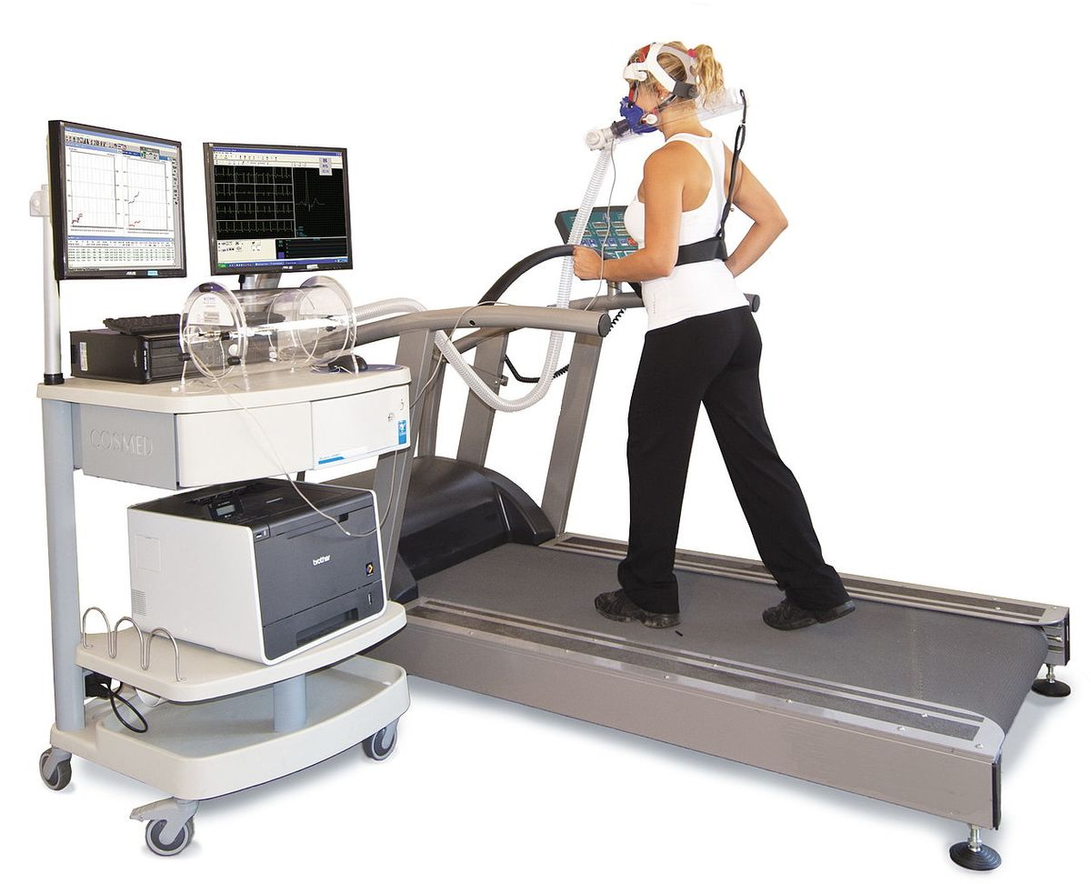
Treadmill
A treadmill is a machine with an endless belt.
A person walks or runs on the belt for exercise or physiological testing
Notes:
A treadmill is a machine that has an endless belt in which an individual runs or walks as a form of exercise or physiological testing. The treadmill is used in cardiopulmonary testing by asking individuals to walk or run on it while their heartbeat and lung capacity are being analyzed.

Slide 8
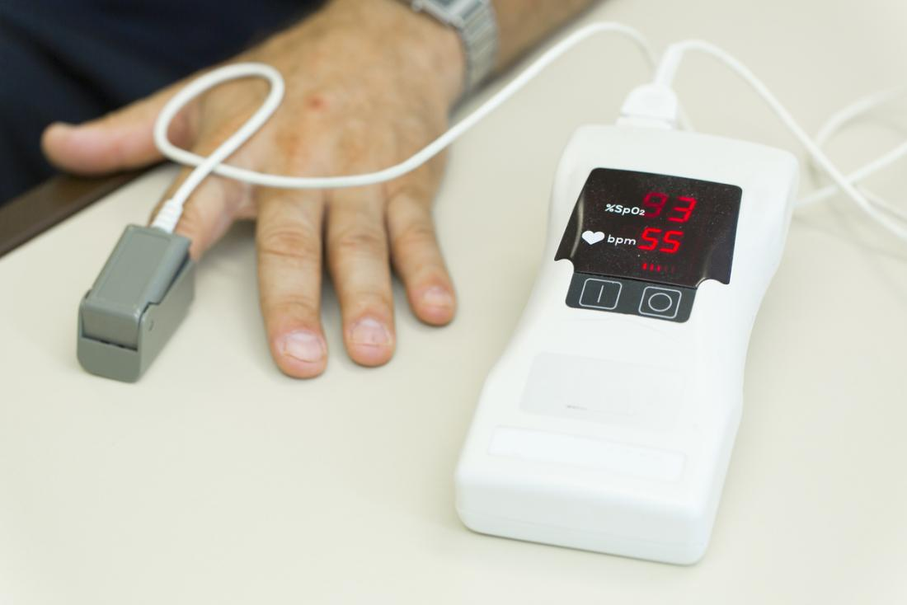
Pulse Oximeter
A pulse oximeter is a device
that slides over a person's fingertip or earlobes.
It uses infrared light refraction
To measure a person's blood oxygen levels.
Notes:
A pulse oximeter is a device used during cardiopulmonary testing to measure the oxygen levels present in an individual's blood. During a cardiopulmonary test, the device is usually slid on a person's fingertip or attached to their earlobe when they are at rest and when performing a mild exercise to establish the oxygen in their blood.

Slide 9
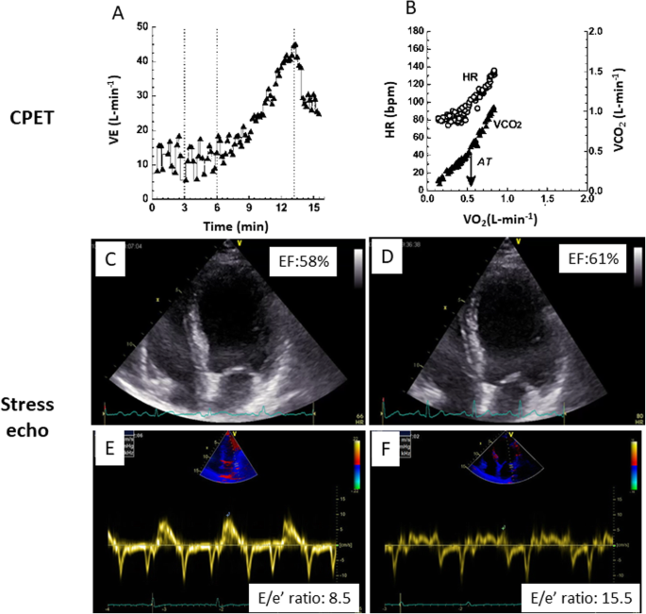
Echocardiogram
An echocardiogram is a graphic outline
of the heart movements.
It is used to establish heart movements.
Including the heart rhythm, heart rate, and changes caused by exercising.
Notes:
An echocardiogram is a graph that indicates the heart movements of an individual when they are at rest and when their body is in motion. During a cardiopulmonary test, an echocardiogram is used to observe the heart rhythm, heartbeat rate, and the changes of the heart palpitations when a person is exercising and when they are at rest to determine their heart and lung capacity.

Slide 10
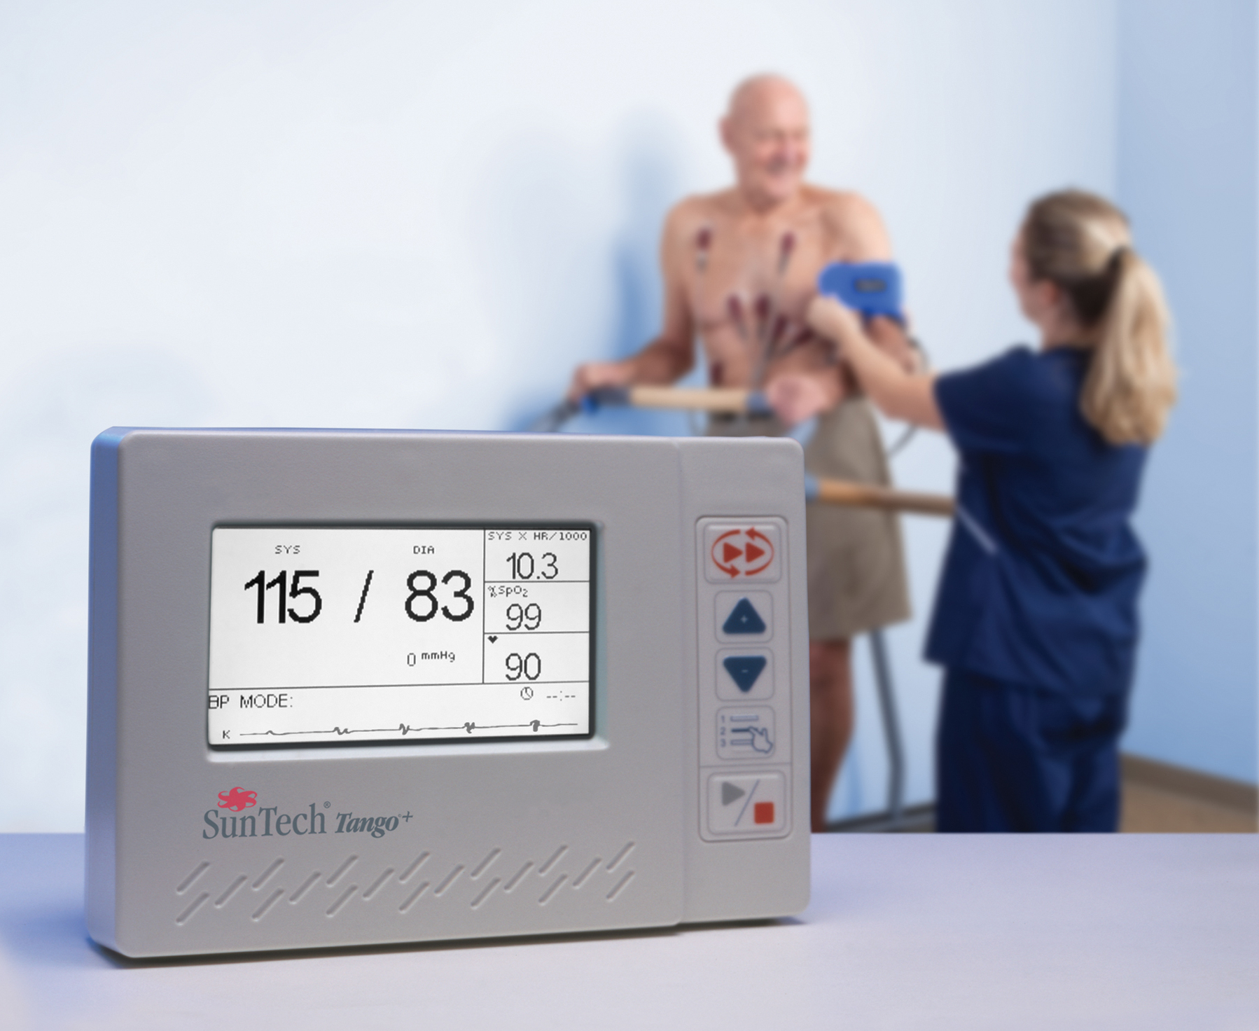
Blood Pressure Monitors
Blood pressure monitors are devices used to
Measure the pressure in the arteries during heart movements
Notes:
During a cardiopulmonary test, stress blood pressure monitors are used to establish a patient's cardiac stress when their bodies are stationary and when doing mild exercises. The blood pressure monitors also indicate the patient's heartbeat, rhythm, and oxygen levels in their body.

Slide 11
Conclusion
A CPET is a method used to analyze heart and lung capacity when exercising and when the body is at rest.
Tools used include treadmills, blood pressure monitors and, pulse oximeters.
A person's vitals are tested before and after exercise and
Their measurements are recorded
Notes:
A cardiopulmonary test also known as a CPET is a technique that is used to monitor the performance of an individuals heart and lungs when they are stationary and while they are exercising. Some of the equipements used for the test include stress blood pressure monitors, pulse oximeters and treadmills among others. A persons vitals are usually tested before and after exercise and a full analysis of their heart rate, rhythm and movements is recorded.

Slide 12
References
Mezzani, A. (2017). Cardiopulmonary exercise testing: basics of methodology and measurements. Annals of the American Thoracic Society, 14(Supplement 1), S3-S11.
Older, P. O., & Levett, D. Z. (2017). Cardiopulmonary exercise testing and surgery. Annals of the American Thoracic Society, 14(Supplement 1), S74-S83.
Faghy, M. A., Sylvester, K. P., Cooper, B. G., & Hull, J. H. (2020). Cardiopulmonary exercise testing in the COVID-19 endemic phase. British journal of anaesthesia, 125(4), 447-449.

